Slide 1
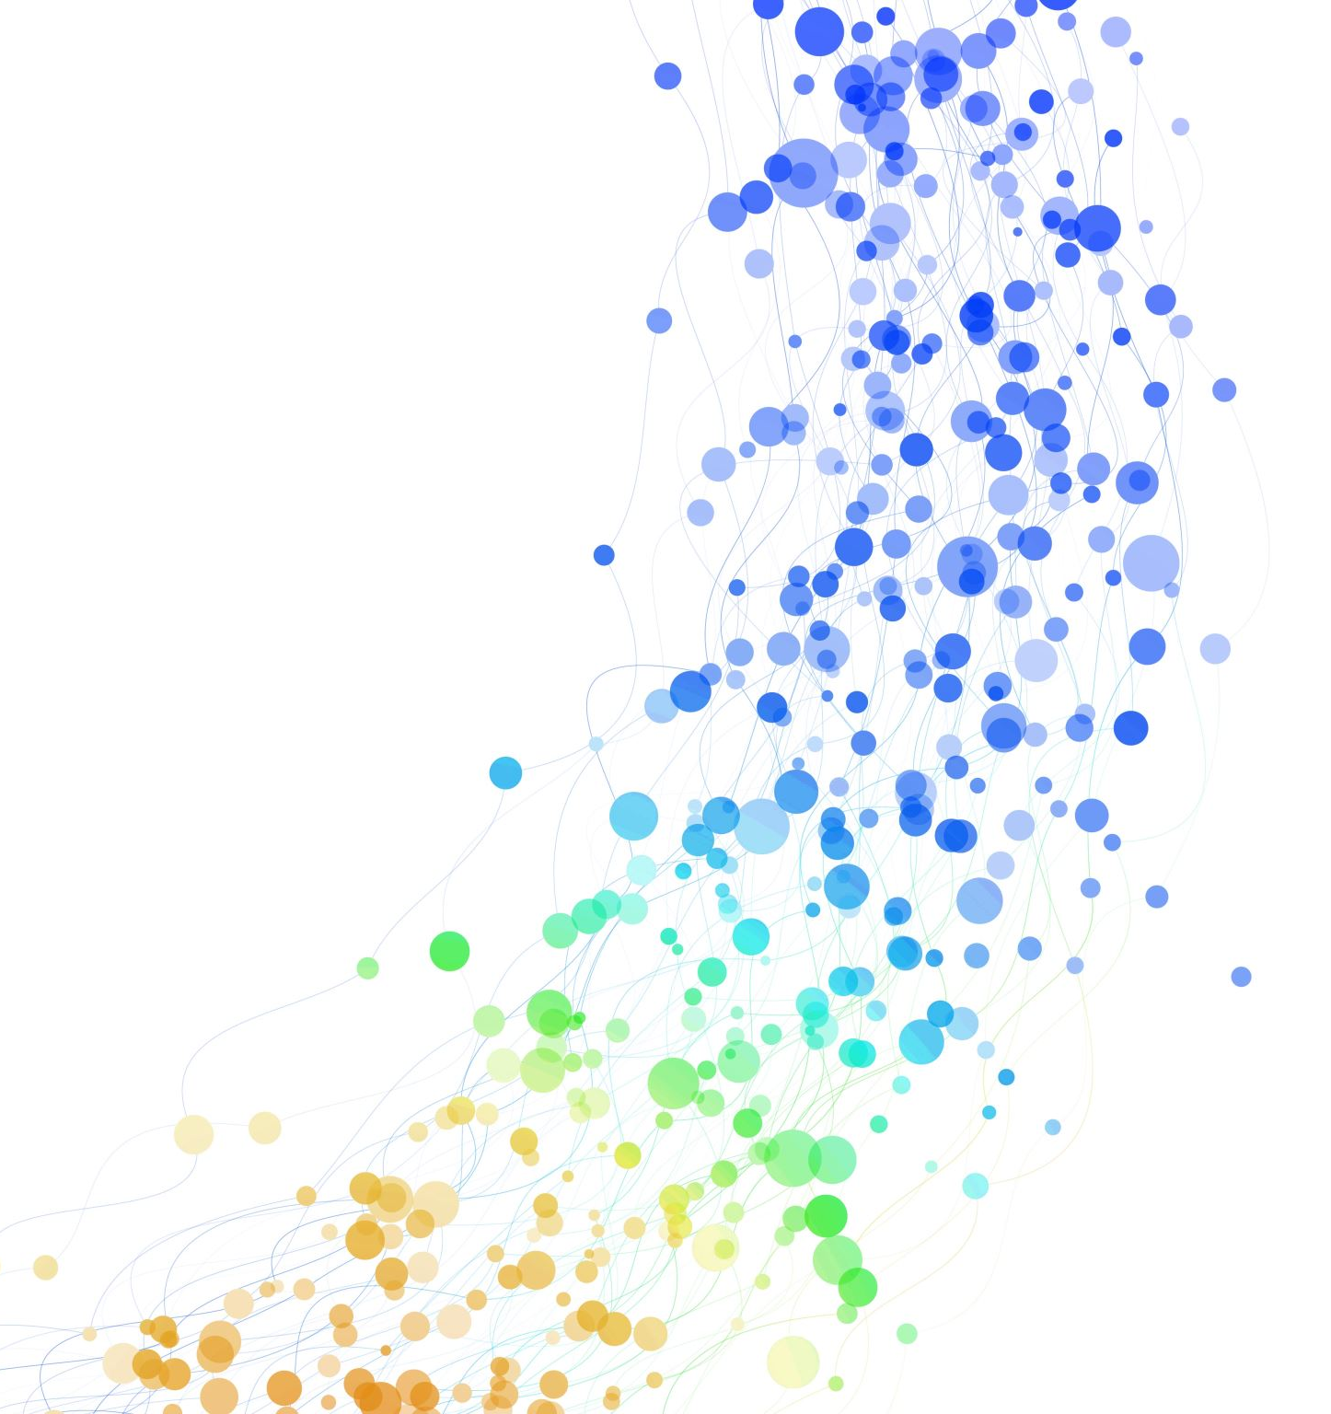
Todo List Management System
22000481 윤요한

Slide 2
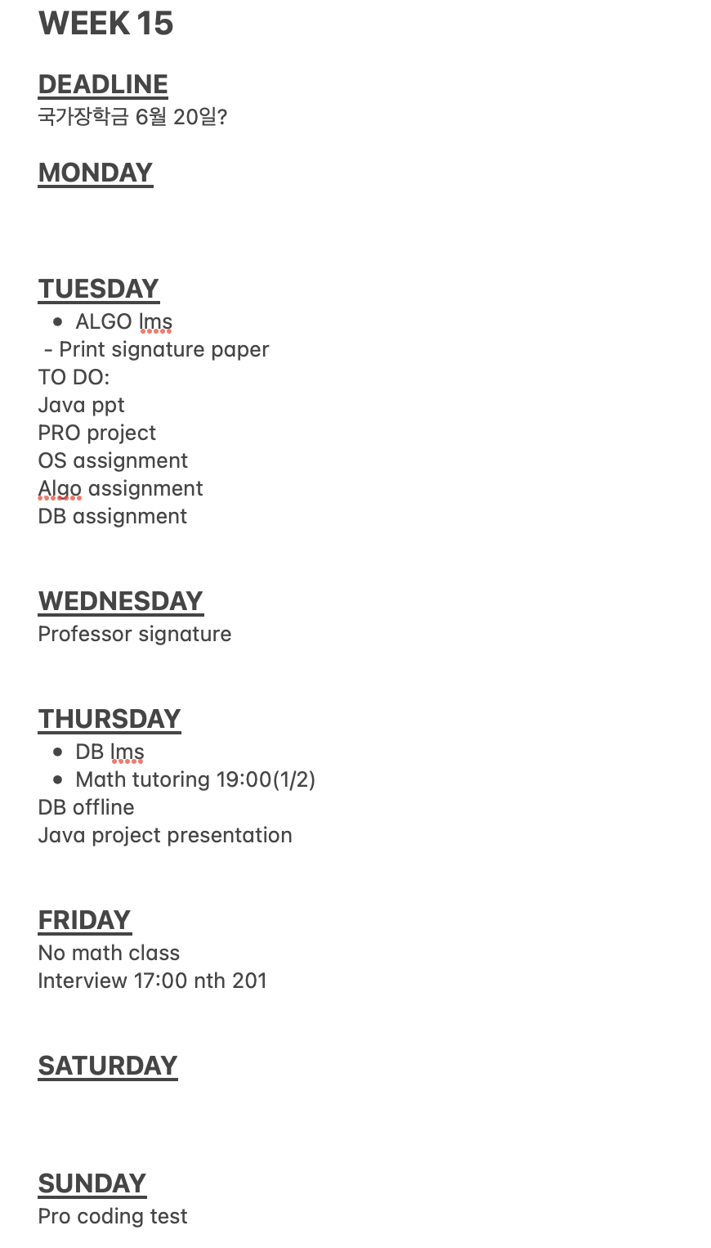
Motive

Slide 3
Implementation
Main
TodoList
Todo
Deadline
Weekly

Slide 4
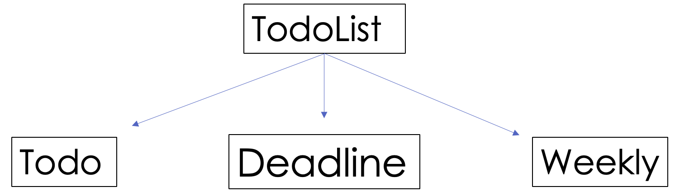
Implementation
Main

Slide 5
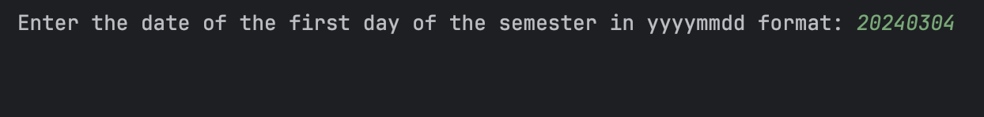
Demo: Initialization

Slide 6
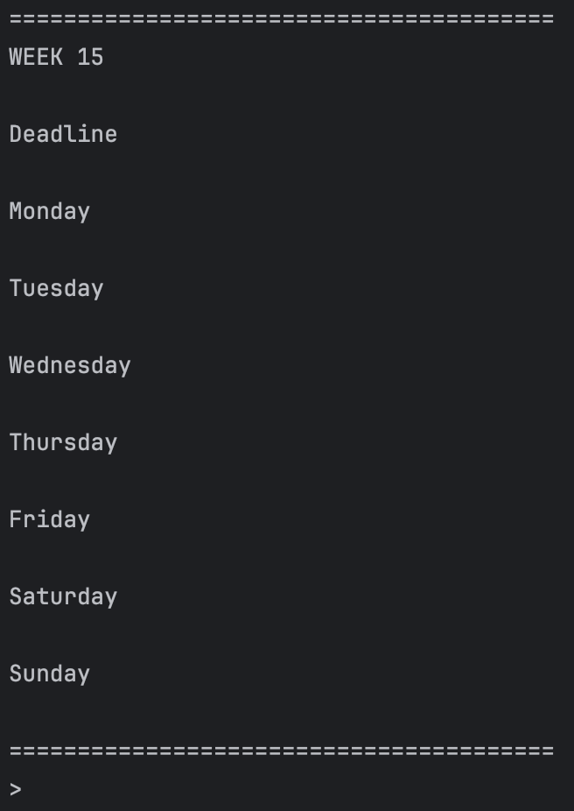
Demo: Initialization

Slide 7
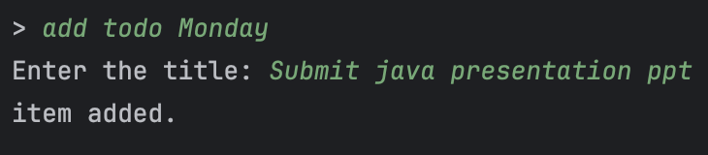
Demo: Add todo

Slide 8
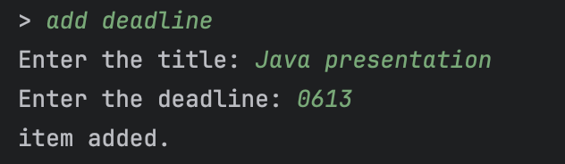
Demo: Add deadline

Slide 9
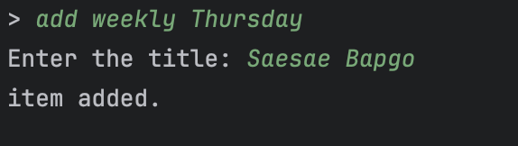
Demo: Add weekly

Slide 10
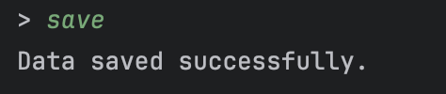
Demo: Save

Slide 11
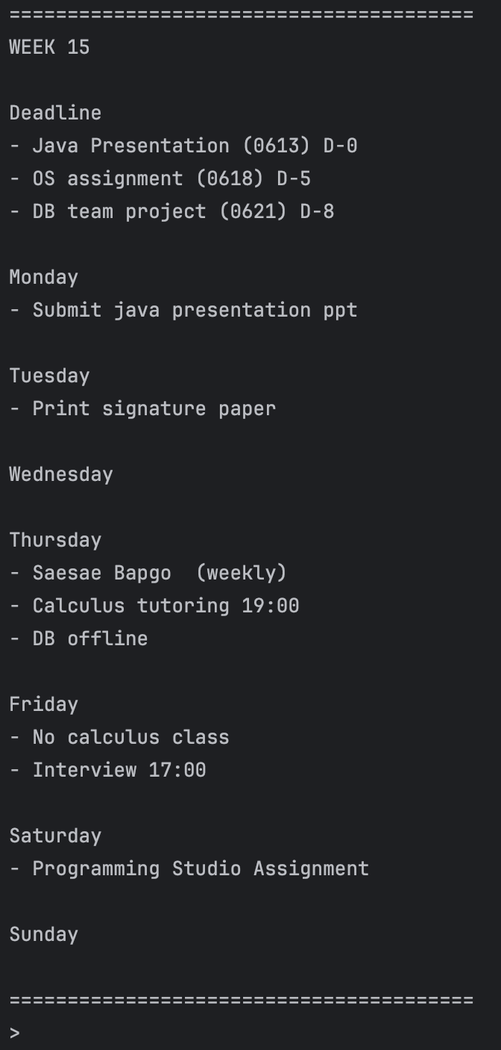
Demo: Result

Slide 12
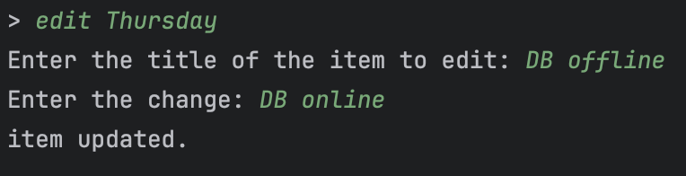
Demo: Edit

Slide 13
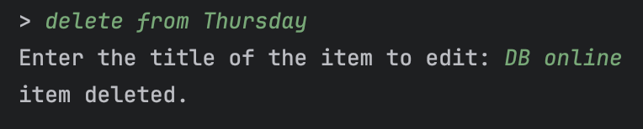
Demo: Delete

Slide 14
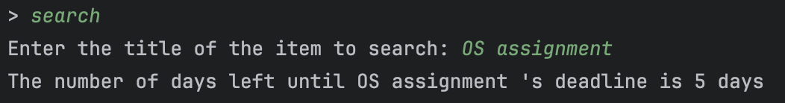
Demo: Search

Slide 15
Thank you!

